Slide 1


LayerNorm & RMSNorm
Optimised SSVE/SME Primitives on Apple M4 —ML Compilers Lab Ketsia Kemkuini
Mariza Sitcheu
Notes:
Opening slide. Project platform: Apple M4 (AArch64, NEON, SSVE, SME). We implement LayerNorm and RMSNorm as SSVE unary primitives with JIT code generation and TEIR integration.

Slide 2
From Proposal to Results
C++ reference, roofline
▼
SSVE kernels
▼
SME / ZA kernel
▼
JIT code generation
▼
Next: TEIR + threading
ML Compilers Lab
2
Notes:
Bridge slide: don't re-present the proposal. Three of four deliverables are done and verified; TEIR is deliberately the outlook. Every kernel was verified against the C++ reference before any benchmark number was trusted.

Slide 3
What Do Optimised ML Libraries Actually Do?
Modern inference libraries share a small set of optimisation families — we isolated and measured each one.
Library | Optimisation families found there
PyTorch (ATen CPU) | vectorised norm kernels · fast inverse-sqrt paths
GGML / llama.cpp | multi-accumulator SIMD reductions
Arm KleidiAI | SME micro-kernels · blocking for access density
ExecuTorch | mobile SIMD normalisation kernels
Our V1–V6 variants isolate these families one at a time — each verified against the reference, then measured against a measured ceiling.
ML Compilers Lab
3
Notes:
Frame V1–V6 as industry-standard technique families, isolated and measured one at a time. BEFORE THE TALK: pin each library attribution to a concrete source file (e.g. GGML ggml-cpu reduction loops, KleidiAI SME micro-kernels) in case an examiner asks 'where exactly?'.

Slide 4
Why SSVE and SME? Matching Tools to the Work
Reductions & elementwise work → SSVE
the per-row statistic and the normalise pass
• predicated, vector-length-agnostic loops — any SVL, tails without branches (WHILELO)
• vector FMLA reductions in Z-registers
• runs for every element → dominates the bandwidth number
2D movement & reuse → SME ZA tile
when data genuinely moves as a 2D block
• SVL×SVL FP32 tile = extra on-core storage
• tile load/store & slice moves (MOVA)
• candidate lever: keep x resident between passes
ML Compilers Lab
4
Notes:
Pre-registering the ZA hypothesis here is what makes the negative verdict on slide 8 a result instead of a failure. SVL is queried at runtime — the 16 comes from the M4's 512-bit SVL, it is never hard-coded.

Slide 5
Kernel Evolution — One Optimisation Family per Version
Version | The one change | Inspired by
V0 | vectorised SSVE baseline, VLA, predicated tails | starting point
V1 | FRSQRTE + Newton step for 1/√ | fast-math practice (PyTorch-style)
V2 | hoist loop-invariant 1/N | classic compiler optimisation
V3 | 2× column-loop unrolling | common SIMD practice
V4 | 4 independent FMLA accumulator chains | GGML / BLIS-style reductions
V5 | software-pipelined load groups | hand-tuned Arm kernels
V6 | 4-row-block contiguity grouping | DRAM access density
ZA | SVL×SVL tile staging / pass fusion | SME's headline feature
ML Compilers Lab
5
Notes:
One change per version keeps every effect attributable. V6 is deliberately NOT called cache blocking: our own measurement showed pass-2 residency was already satisfied; the real lever is DRAM access density/contiguity.

Slide 6
The Decisive Change: V0 → V6 (RMSNorm reduction loop)
V0 — one column touch, one chain
V6 — four blocks per touch, four chains
.Lred_col_loop: ; per column
ld1w {z0.s}, p1/z, [x8] ; ONE load → 64 B
fmla z2.s, p1/m, z0.s, z0.s ; ONE accumulator
add x8, x8, x24 ; next column
subs x9, x9, #1
b.ne .Lred_col_loop
.Lred_col_v6: ; per column
ld1w {z0.s}, p0/z, [x8] ; FOUR loads
ld1w {z24.s}, p0/z, [x8, #1, mul vl] ; = 256 B
ld1w {z25.s}, p0/z, [x8, #2, mul vl] ; contiguous
ld1w {z26.s}, p0/z, [x8, #3, mul vl]
fmla z2.s, p0/m, z0.s, z0.s ; FOUR indep.
fmla z16.s, p0/m, z24.s, z24.s ; accumulator
fmla z17.s, p0/m, z25.s, z25.s ; chains (ILP)
fmla z18.s, p0/m, z26.s, z26.s
add x8, x8, x24
subs x9, x9, #1
b.ne .Lred_col_v6
+131 % in the DRAM regime (11.1 → 25.6 GiB/s) — same math, not one extra FLOP.
ML Compilers Lab
6
Notes:
Walk the two panels: (1) blue lines — four consecutive LD1W = 256 B contiguous per column touch, 4x denser DRAM access; (2) orange lines — four independent FMLA accumulators break the serial dependency chain (this alone was +27-32%, and explains why V3's unrolling did nothing). One accumulator per row-block also keeps reference summation order — no relaxed tolerance needed.

Slide 7
LayerNorm: Two-Pass vs Welford — and vs RMSNorm
 | Two-pass (ours) | Welford single sweep
Memory traffic | 3R + 1W | 2R + 1W (−25 %)
Speed on M4 | faster | 25–30 % slower — serial 1/count recurrence
FP32 accuracy (shift 10⁴) | max err 1.2e-5 | 1.2e-3 (≈100× worse)
Verdict | wins both axes | fewer bytes ≠ faster
Structural gap, measured on the same harness: LayerNorm needs 3R+1W per element, RMSNorm 2R+1W → RMSNorm is 1.8–2.3× faster — well beyond the literature's 10–40 %.
ML Compilers Lab
7
Notes:
Punchline: the 'clever' single-sweep algorithm loses BOTH axes. Speed: the per-column 1/count recurrence serialises on SIMD (a scalar FDIV every column). Accuracy: FP32 Welford rounds the running mean at input magnitude on every element; two-pass squares small centered values. Bottom strip: the structural 3R+1W vs 2R+1W explains why LLaMA-class models picked RMSNorm.

Slide 8
Which Optimisations Mattered — and Which Didn't
Optimisation | RMSNorm | LayerNorm | Why
V1 fast 1/√ | +6.5 % | ≈ 0 | latency only on RMSNorm's critical path
V2 hoist 1/N | ≈ 0 | +9–12 % | LayerNorm has two per-block divides
V3 unrolling | ≈ 0 | ≈ 0 | OOO core + prefetcher already cover it
V4 multi-accumulator | +27–32 % | +26–28 % | breaks the serial FMLA chain (ILP)
V5 load pipelining | ≈ 0 | ≈ 0 | OOO rename already hoists loads
V6 contiguity grouping | +131 %* | +71 %* | 4× denser DRAM access (*DRAM regime, vs V0)
ZA tile staging | −39–65 % | −51–68 % | MOVA traffic > DRAM bytes saved
Verdicts do not transfer between kernels — every lever was re-measured per norm.
ML Compilers Lab
8
Notes:
Read by color: green = kept, gray = no effect (explained), red = rejected. Two teaching points: (1) V2 flips between kernels — verdicts do not transfer, you re-measure; (2) the ZA row is the pre-registered hypothesis from slide 4, measured: staging through the tile (2-3 MOVA per element) costs more than the DRAM reads it saves.

Slide 9
From Hand-Written to Generated: mini_jit::Norm
Norm::generate(ntype)
parameterised on the norm type
Trust by construction — the encoding diff
The generated buffer is compared word-by-word against the proven hand-written kernel:
RMSNorm 143 / 143 words identical
LayerNorm 194 / 194 words identical
→ the JIT inherits the verified kernels' correctness
• runtime parity with hand-written: within 0.6 %
• ZA path deliberately not emitted — it never earned its row (slide 8)
• found along the way: 2 latent week-6 encoder bugs + a per-call sysctl in the bench harness
▼
instruction words
InstGen — 30 new encoders, each unit-tested vs Arm ARM
▼
executable buffer
one streaming region, W^X respected
▼
function pointer
emitted once (~4.7 µs), reused every call
ML Compilers Lab
9
Notes:
The compiler contribution. Trust by construction: instead of re-proving the generated kernel, we diff its instruction words against the hand-written winner that already passed the full suite — word-identical means it inherits that trust. The golden-word unit tests also exposed two latent bugs in the lab's week-6 encoders.

Slide 10
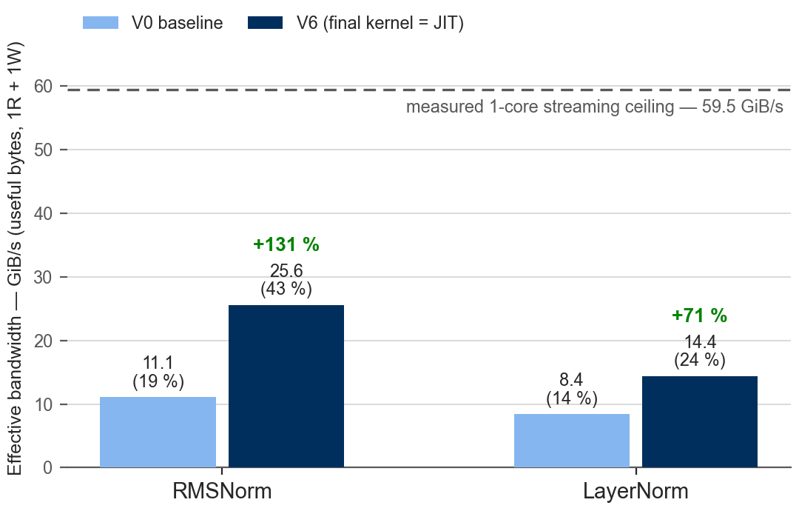
Performance Against the Machine's Measured Ceilings
Ceilings measured on our M4
59.5 GiB/s single-core, streaming mode — the mode our kernels run in (kernel target)
89.8 GiB/s chip-wide, 10 threads — the threading target (outlook)
Chart: 64 MB working set — the true-DRAM regime.
At L2-resident shapes, RMSNorm V6 reaches ~95 % of the ceiling in moved bytes.
JIT kernels = V6 within 0.6 % (word-identical code).
ML Compilers Lab
10
Notes:
All percentages are of the SINGLE-CORE STREAMING ceiling (59.5 GiB/s) — the mode our kernels execute in; we measured it ourselves with a streaming-mode probe. If asked 'why not NEON?': SSVE is the subject of the project, gives 4x wider VLA vectors and is the entry ticket to ZA; the threaded end state targets the chip-wide ceiling where the per-core mode difference washes out. Chart shape: 64 MB working set = true-DRAM regime; at L2-resident shapes V6 reaches ~95 % of the ceiling in moved bytes.

Slide 11
Main Lessons
1
Break dependency chains before tuning arithmetic
4 independent accumulators: +27–32 %. All arithmetic tweaks together: ≤ +6.5 %.
2
Shape memory access for DRAM, not for the FLOP count
256 B-contiguous touches: +131 %. Loop unrolling: 0 %.
3
Newer silicon is not automatically faster
ZA staging lost 39–68 % — hypothesis pre-registered, measured, explained.
Measure, don't assume — every verdict re-measured per kernel, every kernel verified before it was benchmarked.
ML Compilers Lab
11
Notes:
15-second extra story if time allows: our test discipline also caught an eps register-stash bug in 13 of 15 kernels — eps was silently lost across smstart, invisible under every tolerance, NaN on all-zero rows. Fixed everywhere + 2 regression tests. Best concrete evidence for 'measure, don't assume'.

Slide 12
Outlook: From Kernels to Compiler Building Blocks
Done — and verified
Next
C++ reference — the correctness oracle
TEIR primitive — norm registered as an Invocation the runtime places in a loop nest
SSVE V6 kernels — verified, measured vs the ceiling
OpenMP across tiles — threading toward the 89.8 GiB/s chip-wide ceiling
JIT emission — word-identical, parity within 0.6 %
ML Compilers Lab
12
Notes:
The compiler framing: without TEIR these are optimised standalone kernels; with TEIR the compiler places the norm inside real model graphs. Threading across tiles (is_parallel on the row axis) then targets the 89.8 GiB/s chip-wide ceiling — one core already sustains ~66 % of it, so expect ≤1.5×, measured honestly.

